Slide 1
Performance and Tuning

Slide 2
Performance Tuning
Adjusting various parameters and design choices to improve system performance for a specific application.
Tuning is best done by
identifying bottlenecks, and
eliminating them
Can tune a database system at 3 levels:
Hardware -- e.g., add disks to speed up I/O, add memory to increase buffer hits, move to a faster processor.
Database system parameters -- e.g., set buffer size to avoid paging of buffer, set checkpointing intervals to limit log size. System may have automatic tuning.
Higher level database design, such as the schema, indices and transactions

Slide 3
Bottlenecks
Performance of most systems (at least before they are tuned) usually limited by performance of one or a few components: these are called bottlenecks
E.g. 80% of the code may take up 20% of time and 20% of code takes up 80% of time
Worth spending most time on 20% of code that take 80% of time
Bottlenecks may be in hardware (e.g. disks are very busy, CPU is idle), or in software
Removing one bottleneck often exposes another
De-bottlenecking consists of repeatedly finding bottlenecks, and removing them
This is a heuristic

Slide 4
Identifying Bottlenecks
Transactions request a sequence of services
e.g. CPU, Disk I/O, locks
With concurrent transactions, transactions may have to wait for a requested service while other transactions are being served
Can model database as a queueing system with a queue for each service
transactions repeatedly do the following
request a service, wait in queue for the service, and get serviced
Bottlenecks in a database system typically show up as very high utilizations (and correspondingly, very long queues) of a particular service
E.g. disk vs CPU utilization
100% utilization leads to very long waiting time:
Rule of thumb: design system for about 70% utilization at peak load
utilization over 90% should be avoided

Slide 5
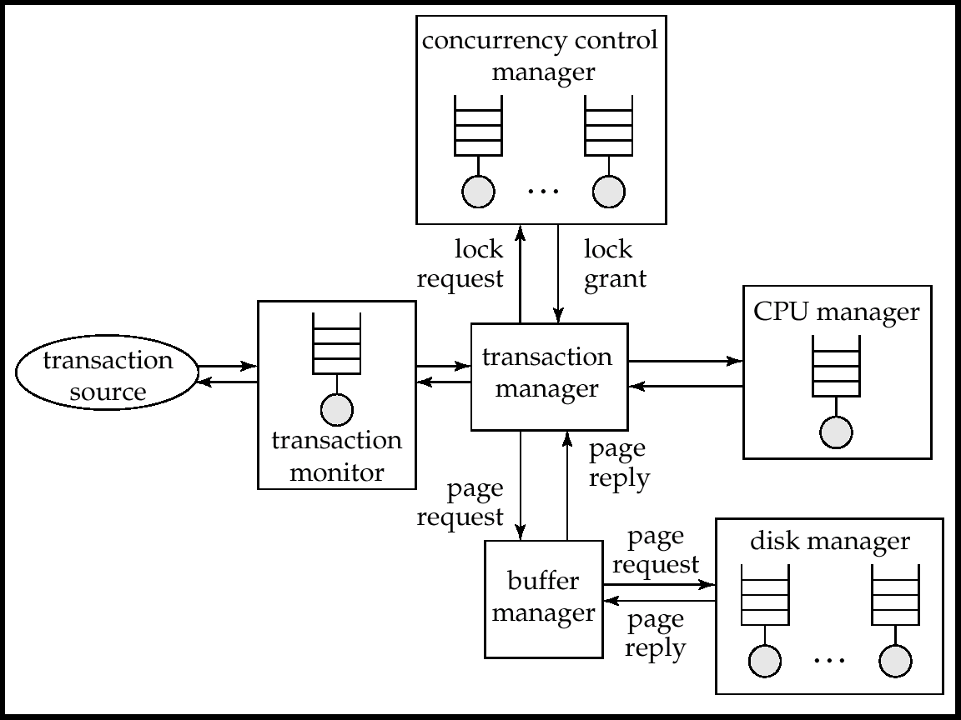
Queues In A Database System

Slide 6
Tunable Parameters
Tuning of hardware
Tuning of schema
Tuning of indices
Tuning of materialized views
Tuning of transactions

Slide 7
Tuning of Hardware
Even well-tuned transactions typically require a few I/O operations
Typical disk supports about 100 random I/O operations per second
Suppose each transaction requires just 2 random I/O operations. Then to support n transactions per second, we need to stripe data across n/50 disks
Number of I/O operations per transaction can be reduced by keeping more data in memory
If all data is in memory, I/O needed only for writes
Keeping frequently used data in memory reduces disk accesses, reducing number of disks required, but has a memory cost

Slide 8
Tuning the Database Design
Schema tuning
Vertically partition relations to isolate the data that is accessed most often -- only fetch needed information.
E.g., split account into two, (account-number, branch-name) and (account-number, balance).
Branch-name need not be fetched unless required
Improve performance by storing a denormalized relation
E.g., store join of account and depositor; branch-name and balance information is repeated for each holder of an account, but join need not be computed repeatedly.
Price paid: more space and more work for programmer to keep relation consistent on updates
better to use materialized views (more on this later..)
Cluster together on the same disk page records that would match in a frequently required join,
compute join very efficiently when required.

Slide 9
Tuning the Database Design (Cont.)
Index tuning
Create appropriate indices to speed up slow queries/updates
Speed up slow updates by removing excess indices (tradeoff between queries and updates)
Choose type of index (B-tree/hash) appropriate for most frequent types of queries.
Choose which index to make clustered
Index tuning wizards look at past history of queries and updates (the workload) and recommend which indices would be best for the workload

Slide 10
Tuning the Database Design (Cont.)
Materialized Views
Materialized views can help speed up certain queries
Particularly aggregate queries
Overheads
Space
Time for view maintenance
Immediate view maintenance:done as part of update txn
time overhead paid by update transaction
Deferred view maintenance: done only when required
update transaction is not affected, but system time is spent on view maintenance
until updated, the view may be out-of-date
Preferable to denormalized schema since view maintenance is systems responsibility, not programmers
Avoids inconsistencies caused by errors in update programs

Slide 11
Tuning the Database Design (Cont.)
How to choose set of materialized views
Helping one transaction type by introducing a materialized view may hurt others
Choice of materialized views depends on costs
Users often have no idea of actual cost of operations
Overall, manual selection of materialized views is tedious
Some database systems provide tools to help DBA choose views to materialize
“Materialized view selection wizards”

Slide 12
Tuning of Transactions
Basic approaches to tuning of transactions
Improve set orientation
Reduce lock contention
Rewriting of queries to improve performance was important in the past, but smart optimizers have made this less important
Communication overhead and query handling overheads significant part of cost of each call
Combine multiple embedded SQL/ODBC/JDBC queries into a single set-oriented query
Set orientation -> fewer calls to database
E.g. tune program that computes total salary for each department using a separate SQL query by instead using a single query that computes total salaries for all department at once (using group by)
Use stored procedures: avoids re-parsing and re-optimization of query

Slide 13
Tuning of Transactions (Cont.)
Reducing lock contention
Long transactions (typically read-only) that examine large parts of a relation result in lock contention with update transactions
E.g. large query to compute bank statistics and regular bank transactions
To reduce contention, do one of the following:
Use multi-version concurrency control
E.g. versioned relations in SQL Server 2005
Use snapshot isolation
Not serializable in some cases, but better performance than 2PL
Default in Oracle/PostgreSQL, optional in SQL Server 2005
Use degree-two consistency (cursor-stability) for long transactions
Drawback: result may be approximate

Slide 14
Tuning of Transactions (Cont.)
Long update transactions cause several problems
Exhaust lock space
Exhaust log space
and also greatly increase recovery time after a crash, and may even exhaust log space during recovery if recovery algorithm is badly designed!
Use mini-batch transactions to limit number of updates that a single transaction can carry out. E.g., if a single large transaction updates every record of a very large relation, log may grow too big.
* Split large transaction into batch of ``mini-transactions,'' each performing part of the updates
Hold locks across transactions in a mini-batch to ensure serializability
If lock table size is a problem can release locks, but at the cost of serializability
* In case of failure during a mini-batch, must complete its remaining portion on recovery, to ensure atomicity.

Slide 15
Performance Simulation
Performance simulation using queuing model useful to predict bottlenecks as well as the effects of tuning changes, even without access to real system
Queuing model as we saw earlier
Models activities that go on in parallel
Simulation model is quite detailed, but usually omits some low level details
Model service time, but disregard details of service
E.g. approximate disk read time by using an average disk read time
Experiments can be run on model, and provide an estimate of measures such as average throughput/response time
Parameters can be tuned in model and then replicated in real system
E.g. number of disks, memory, algorithms, etc

Slide 16
Performance Benchmarks
Suites of tasks used to quantify the performance of software systems
Important in comparing database systems, especially as systems become more standards compliant.
Commonly used performance measures:
Throughput (transactions per second, or tps)
Response time (delay from submission of transaction to return of result)
Availability or mean time to failure

Slide 17
Performance Benchmarks (Cont.)
Suites of tasks used to characterize performance
single task not enough for complex systems
Beware when computing average throughput of different transaction types
E.g., suppose a system runs transaction type A at 99 tps and transaction type B at 1 tps.
Given an equal mixture of types A and B, throughput is not (99+1)/2 = 50 tps.
Running one transaction of each type takes time 1+.01 seconds, giving a throughput of 1.98 tps.
To compute average throughput, use harmonic mean:
n
Interference (e.g. lock contention) makes even this incorrect if different transaction types run concurrently
1/t₁ + 1/t₂ + … + 1/t_{n}

Slide 18
Database Application Classes
Online transaction processing (OLTP)
requires high concurrency and clever techniques to speed up commit processing, to support a high rate of update transactions.
Decision support applications
including online analytical processing, or OLAP applications
require good query evaluation algorithms and query optimization.
Architecture of some database systems tuned to one of the two classes
E.g. Teradata is tuned to decision support
Others try to balance the two requirements
E.g. Oracle, with snapshot support for long read-only transaction

Slide 19
Benchmarks Suites
The Transaction Processing Council (TPC) benchmark suites are widely used.
TPC-A and TPC-B: simple OLTP application modeling a bank teller application with and without communication
Not used anymore
TPC-C: complex OLTP application modeling an inventory system
Current standard for OLTP benchmarking

Slide 20
Benchmarks Suites (Cont.)
TPC benchmarks (cont.)
TPC-D: complex decision support application
Superceded by TPC-H and TPC-R
TPC-H: (H for ad hoc) based on TPC-D with some extra queries
Models ad hoc queries which are not known beforehand
Total of 22 queries with emphasis on aggregation
prohibits materialized views
permits indices only on primary and foreign keys
TPC-R: (R for reporting) same as TPC-H, but without any restrictions on materialized views and indices
TPC-W: (W for Web) End-to-end Web service benchmark modeling a Web bookstore, with combination of static and dynamically generated pages

Slide 21
TPC Performance Measures
TPC performance measures
transactions-per-second with specified constraints on response time
transactions-per-second-per-dollar accounts for cost of owning system
TPC benchmark requires database sizes to be scaled up with increasing transactions-per-second
reflects real world applications where more customers means more database size and more transactions-per-second
External audit of TPC performance numbers mandatory
TPC performance claims can be trusted

Slide 22
TPC Performance Measures
Two types of tests for TPC-H and TPC-R
Power test: runs queries and updates sequentially, then takes mean to find queries per hour
Throughput test: runs queries and updates concurrently
multiple streams running in parallel each generates queries, with one parallel update stream
Composite query per hour metric: square root of product of power and throughput metrics
Composite price/performance metric

